Slide 1
Networking Technologies
AICT012-4-2 and Version VE3
IPv4 Addressing

Slide 2
Topic & Structure of The Lesson
Topic Title | Topic Objective
IPv4 Address Structure | Describe the structure of an IPv4 address including the network portion, the host portion, and the subnet mask.
IPv4 Unicast, Broadcast, and Multicast | Compare the characteristics and uses of the unicast, broadcast and multicast IPv4 addresses.
Types of IPv4 Addresses | Explain public, private, and reserved IPv4 addresses.
Network Segmentation | Explain how subnetting segments a network to enable better communication.
Subnet an IPv4 Network | Calculate IPv4 subnets for a /24 prefix.

Slide 3
Learning Outcomes
At the end of this topic, You should be able to:
Convert between binary and decimal numbering systems.
Describe the structure of an IPv4 address including the network portion, the host portion, and the subnet mask.
Compare the characteristics and uses of the unicast, broadcast, and multicast IPv4 addresses.
Explain public, private, and reserved IPv4 addresses.
Explain the need for IPv6 addressing.
Describe the representation of an IPv6 address.
Describe types of IPv6 network addresses.
Explain how ICMP is used to test network connectivity.
Use ping and traceroute utilities to test network connectivity

Slide 4
Key Terms You Must Be Able To Use
If you have mastered this topic, you should be able to use the following terms correctly in your assignments and exams:
binary and decimal
octet
prefix length
network address
broadcast address
subnet mask
public and private IPv4 address

Slide 5
8.1 IPv4 Address Structure
Notes:
Cisco Networking Academy Program
Introduction to Networks v6.0
Chapter 11: IPv4 Addressing

Slide 6
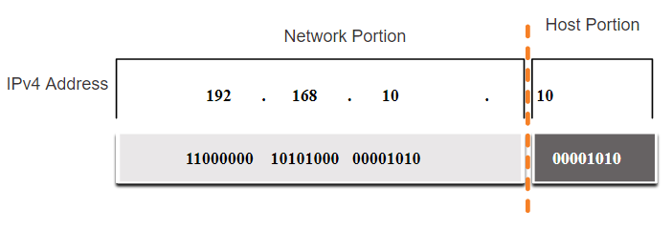
IPv4 Address Structure Network and Host Portions
An IPv4 address is a 32-bit hierarchical address that is made up of a network portion and a host portion.
When determining the network portion versus the host portion, you must look at the 32-bit stream.
A subnet mask is used to determine the network and host portions.
Notes:
11 – IPv4 Addressing
11.1 – IPv4 Address Structure
11.1.1 – Network and Host Portions

Slide 7
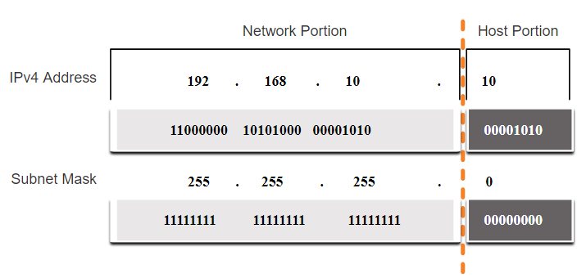
IPv4 Address Structure The Subnet Mask
To identify the network and host portions of an IPv4 address, the subnet mask is compared to the IPv4 address bit for bit, from left to right.
The actual process used to identify the network and host portions is called ANDing.
Notes:
11 – IPv4 Addressing
11.1 – IPv4 Address Structure
11.1.2 – The Subnet Mask

Slide 8
IPv4 Address Structure The Prefix Length
A prefix length is a less cumbersome method used to identify a subnet mask address.
Subnet Mask | 32-bit Address | Prefix Length
255.0.0.0 | 11111111.00000000.00000000.00000000 | /8
255.255.0.0 | 11111111.11111111.00000000.00000000 | /16
255.255.255.0 | 11111111.11111111.11111111.00000000 | /24
255.255.255.128 | 11111111.11111111.11111111.10000000 | /25
255.255.255.192 | 11111111.11111111.11111111.11000000 | /26
255.255.255.224 | 11111111.11111111.11111111.11100000 | /27
255.255.255.240 | 11111111.11111111.11111111.11110000 | /28
255.255.255.248 | 11111111.11111111.11111111.11111000 | /29
255.255.255.252 | 11111111.11111111.11111111.11111100 | /30
The prefix length is the number of bits set to 1 in the subnet mask.
It is written in “slash notation” therefore, count the number of bits in the subnet mask and prepend it with a slash.
Notes:
11 – IPv4 Addressing
11.1 – IPv4 Address Structure
11.1.3 – The Prefix Length

Slide 9
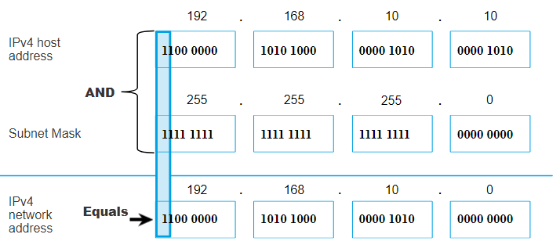
IPv4 Address Structure Determining the Network: Logical AND
A logical AND Boolean operation is used in determining the network address.
Logical AND is the comparison of two bits where only a 1 AND 1 produces a 1 and any other combination results in a 0.
1 AND 1 = 1, 0 AND 1 = 0, 1 AND 0 = 0, 0 AND 0 = 0
1 = True and 0 = False
To identify the network address, the host IPv4 address is logically ANDed, bit by bit, with the subnet mask to identify the network address.
Notes:
11 – IPv4 Addressing
11.1 – IPv4 Address Structure
11.1.4 – Determining the Network: Logical AND

Slide 10
Video – Network, Host and Broadcast Addresses
Notes:
2 – Basic Switch and End Device Configuration
2.2 – IOS Navigation
2.2.4 – Navigate Between IOS Modes

Slide 11
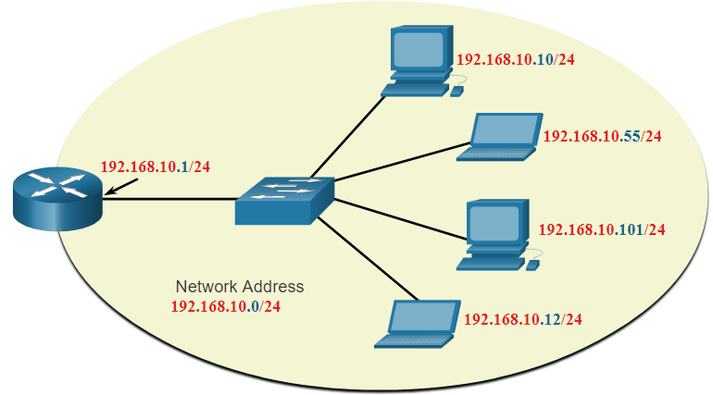
IPv4 Address Structure Network, Host, and Broadcast Addresses
Within each network are three types of IP addresses:
Network address
Host addresses
Broadcast address
 | Network Portion | Host Portion | Host Bits
Subnet mask 255.255.255.0 or /24 | 255 255 255 11111111 11111111 11111111 | 0 00000000
Network address 192.168.10.0 or /24 | 192 168 10 11000000 10100000 00001010 | 0 00000000 | All 0s
First address 192.168.10.1 or /24 | 192 168 10 11000000 10100000 00001010 | 1 00000001 | All 0s and a 1
Last address 192.168.10.254 or /24 | 192 168 10 11000000 10100000 00001010 | 254 11111110 | All 1s and a 0
Broadcast address 192.168.10.255 or /24 | 192 168 10 11000000 10100000 00001010 | 255 11111111 | All 1s
Notes:
11 – IPv4 Addressing
11.1 – IPv4 Address Structure
11.1.6 – Network, Host, and Broadcast Addresses
11.1.7 – Activity – ANDing to Determine the Network Address
11.1.8 – Check Your Understanding - IPv4 Address Structure

Slide 12
Activity in Netacad: ANDing to Determine the Network Address
Notes:
2 – Basic Switch and End Device Configuration
2.2 – IOS Navigation
2.2.4 – Navigate Between IOS Modes

Slide 13
Check your understanding – 8.1 IPv4 Address Structure
Notes:
2 – Basic Switch and End Device Configuration
2.2 – IOS Navigation
2.2.4 – Navigate Between IOS Modes

Slide 14
8.2 IPv4 Unicast, Broadcast, and Multicast
Notes:
Cisco Networking Academy Program
Introduction to Networks v6.0
Chapter 11: IPv4 Addressing

Slide 15
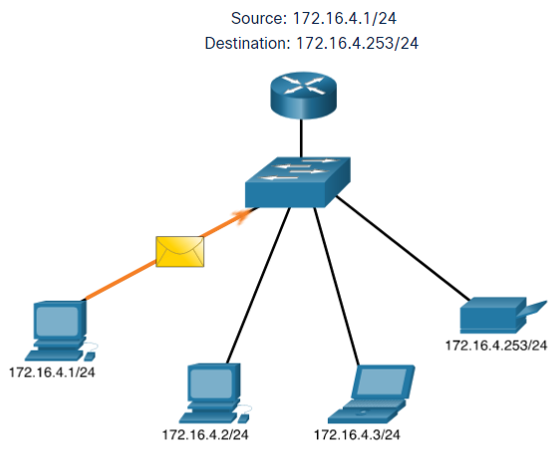
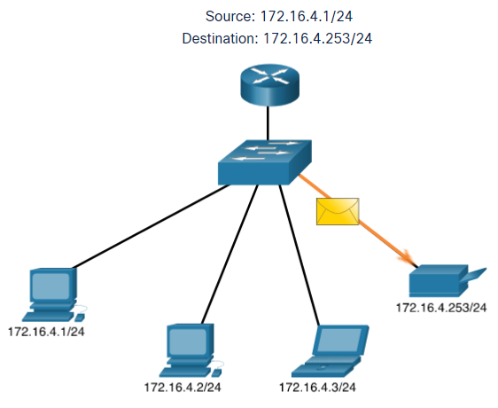
IPv4 Unicast, Broadcast, and Multicast Unicast
Unicast transmission is sending a packet to one destination IP address.
For example, the PC at 172.16.4.1 sends a unicast packet to the printer at 172.16.4.253.
Notes:
11 – IPv4 Addressing
11.2 – IPv4 Unicast, Broadcast, and Multicast
11.2.1 – Unicast

Slide 16
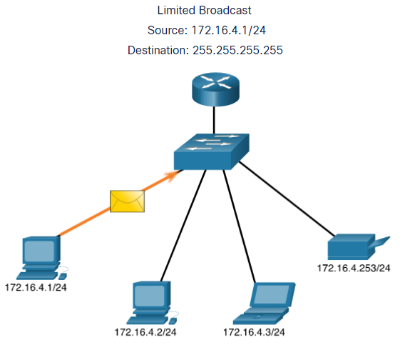
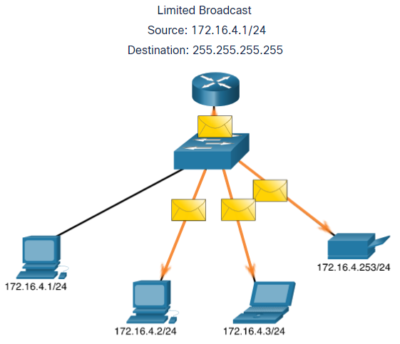
IPv4 Unicast, Broadcast, and Multicast Broadcast
Broadcast transmission is sending a packet to all other destination IP addresses.
For example, the PC at 172.16.4.1 sends a broadcast packet to all IPv4 hosts.
Notes:
11 – IPv4 Addressing
11.2 – IPv4 Unicast, Broadcast, and Multicast
11.2.2 – Broadcast

Slide 17
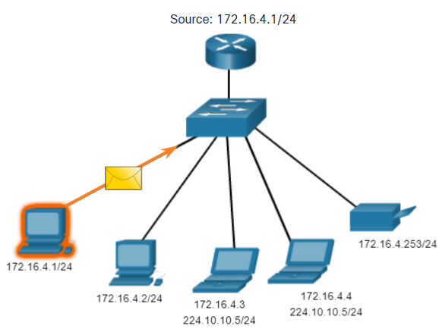
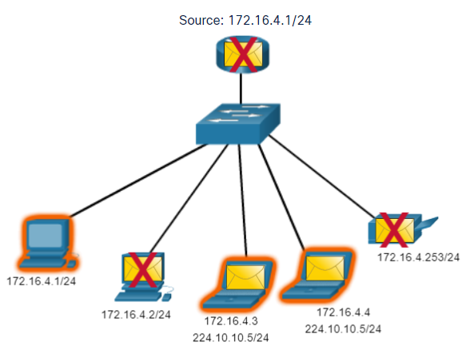
IPv4 Unicast, Broadcast, and Multicast Multicast
Multicast transmission is sending a packet to a multicast address group.
For example, the PC at 172.16.4.1 sends a multicast packet to the multicast group address 224.10.10.5.
Notes:
11 – IPv4 Addressing
11.2 – IPv4 Unicast, Broadcast, and Multicast
11.2.3 – Multicast
11.2.4 – Activity - Unicast, Broadcast, or Multicast

Slide 18
Activity in Netacad: Unicast, Broadcast, or Multicast
Notes:
2 – Basic Switch and End Device Configuration
2.2 – IOS Navigation
2.2.4 – Navigate Between IOS Modes

Slide 19
8.3 Types of IPv4 Addresses
Notes:
Cisco Networking Academy Program
Introduction to Networks v6.0
Chapter 11: IPv4 Addressing

Slide 20
Types of IPv4 Addresses Public and Private IPv4 Addresses
As defined in in RFC 1918, public IPv4 addresses are globally routed between internet service provider (ISP) routers.
However, private addresses are not globally routable.
Private addresses are common blocks of addresses used by most organizations to assign IPv4 addresses to internal hosts.
Private IPv4 addresses are not unique and can be used internally within any network.
Network Address and Prefix | RFC 1918 Private Address Range
10.0.0.0/8 | 10.0.0.0 - 10.255.255.255
172.16.0.0/12 | 172.16.0.0 - 172.31.255.255
192.168.0.0/16 | 192.168.0.0 - 192.168.255.255
Notes:
11 – IPv4 Addressing
11.3 – Types of IPv4 Addresses
11.3.1 – Public and Private IPv4 Addresses

Slide 21
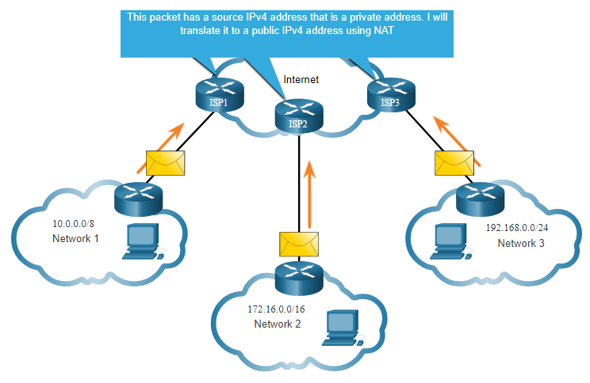
Types of IPv4 Addresses Routing to the Internet
Network Address Translation (NAT) translates private IPv4 addresses to public IPv4 addresses.
NAT is typically enabled on the edge router connecting to the internet.
It translates the internal private address to a public global IP address.
Notes:
11 – IPv4 Addressing
11.3 – Types of IPv4 Addresses
11.3.2 – Routing to the Internet
11.3.3 – Activity - Pass or Block IPv4 Addresses

Slide 22
Activity in Netacad: Pass or Block IPv4 Addresses
Notes:
2 – Basic Switch and End Device Configuration
2.2 – IOS Navigation
2.2.4 – Navigate Between IOS Modes

Slide 23
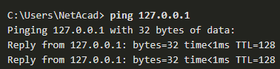
Types of IPv4 Addresses Special Use IPv4 Addresses
Loopback addresses
127.0.0.0 /8 (127.0.0.1 to 127.255.255.254)
Commonly identified as only 127.0.0.1
Used on a host to test if TCP/IP is operational.
Link-Local addresses
169.254.0.0 /16 (169.254.0.1 to 169.254.255.254)
Commonly known as the Automatic Private IP Addressing (APIPA) addresses or self-assigned addresses.
Used by Windows DHCP clients to self-configure when no DHCP servers are available.
Notes:
11 – IPv4 Addressing
11.3 – Types of IPv4 Addresses
11.3.4 – Special Use IPv4 Addresses

Slide 24
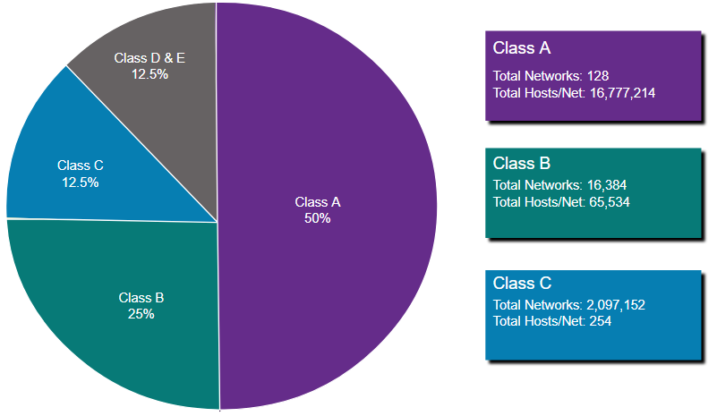
Types of IPv4 Addresses Legacy Classful Addressing
RFC 790 (1981) allocated IPv4 addresses in classes
Class A (0.0.0.0/8 to 127.0.0.0/8)
Class B (128.0.0.0 /16 – 191.255.0.0 /16)
Class C (192.0.0.0 /24 – 223.255.255.0 /24)
Class D (224.0.0.0 to 239.0.0.0)
Class E (240.0.0.0 – 255.0.0.0)
Classful addressing wasted many IPv4 addresses.
Classful address allocation was replaced with classless addressing which ignores the rules of classes (A, B, C).
Notes:
11 – IPv4 Addressing
11.3 – Types of IPv4 Addresses
11.3.5 – Legacy Classful Addressing

Slide 25
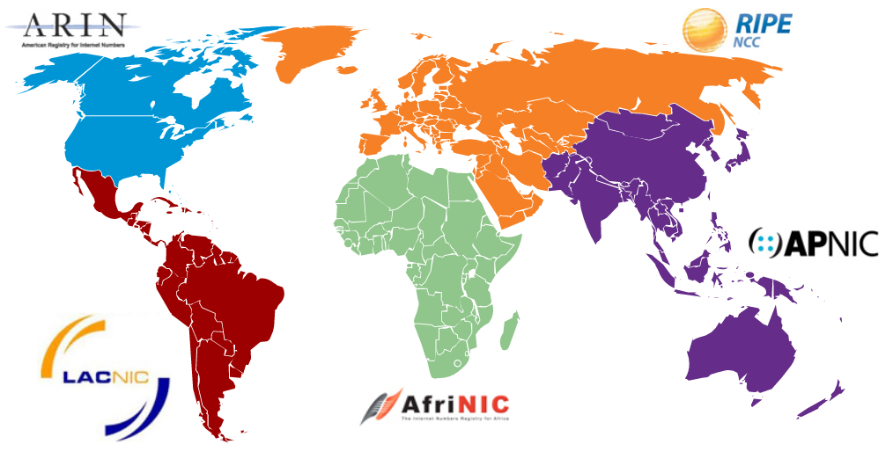
Types of IPv4 Addresses Assignment of IP Addresses
The Internet Assigned Numbers Authority (IANA) manages and allocates blocks of IPv4 and IPv6 addresses to five Regional Internet Registries (RIRs).
RIRs are responsible for allocating IP addresses to ISPs who provide IPv4 address blocks to smaller ISPs and organizations.
Notes:
11 – IPv4 Addressing
11.3 – Types of IPv4 Addresses
11.3.6 – Assignment of IP Addresses
11.3.7 – Activity - Public or Private IPv4 Address
11.3.8 – Check Your Understanding - Types of IPv4 Addresses

Slide 26
Activity in Netacad: Public or Private IPv4 Address
Notes:
2 – Basic Switch and End Device Configuration
2.2 – IOS Navigation
2.2.4 – Navigate Between IOS Modes

Slide 27
Check your understanding – 8.3 Types of IPv4 Addresses
Notes:
2 – Basic Switch and End Device Configuration
2.2 – IOS Navigation
2.2.4 – Navigate Between IOS Modes

Slide 28
8.4 Network Segmentation
Notes:
Cisco Networking Academy Program
Introduction to Networks v6.0
Chapter 11: IPv4 Addressing

Slide 29
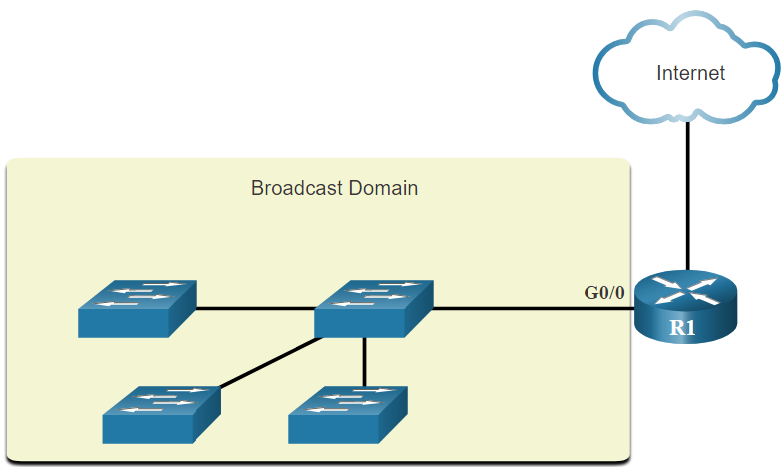
Network Segmentation Broadcast Domains and Segmentation
Many protocols use broadcasts or multicasts (e.g., ARP use broadcasts to locate other devices, hosts send DHCP discover broadcasts to locate a DHCP server.)
Switches propagate broadcasts out all interfaces except the interface on which it was received.
The only device that stops broadcasts is a router.
Routers do not propagate broadcasts.
Each router interface connects to a broadcast domain and broadcasts are only propagated within that specific broadcast domain.
Notes:
11 – IPv4 Addressing
11.4 – Network Segmentation
11.4.1 – Broadcast Domains and Segmentation

Slide 30
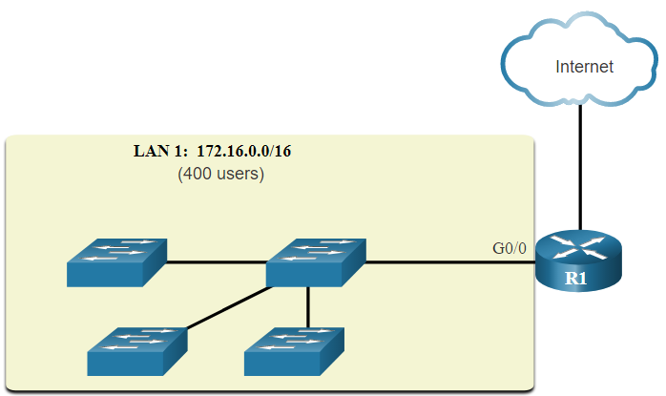
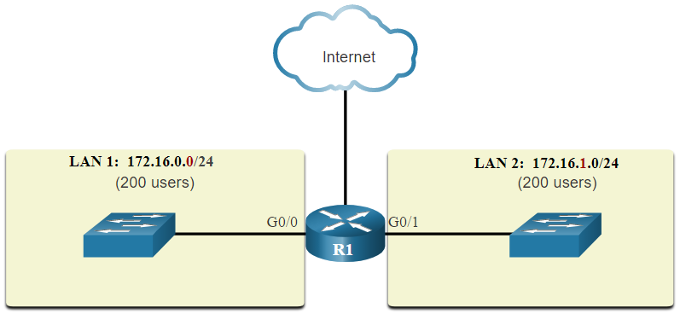
Network Segmentation Problems with Large Broadcast Domains
A problem with a large broadcast domain is that these hosts can generate excessive broadcasts and negatively affect the network.
The solution is to reduce the size of the network to create smaller broadcast domains in a process called subnetting.
Dividing the network address 172.16.0.0 /16 into two subnets of 200 users each: 172.16.0.0 /24 and 172.16.1.0 /24.
Broadcasts are only propagated within the smaller broadcast domains.
Notes:
11 – IPv4 Addressing
11.4 – Network Segmentation
11.4.2 – Problems with Large Broadcast Domains

Slide 31
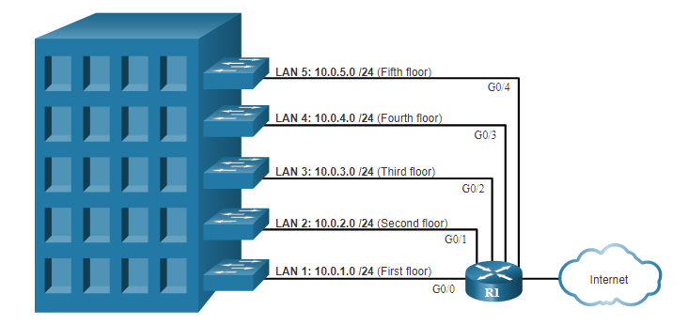
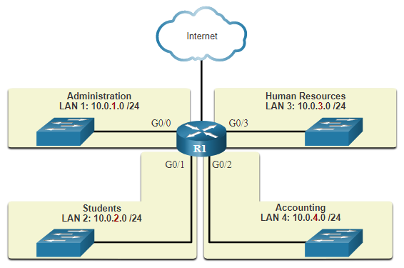
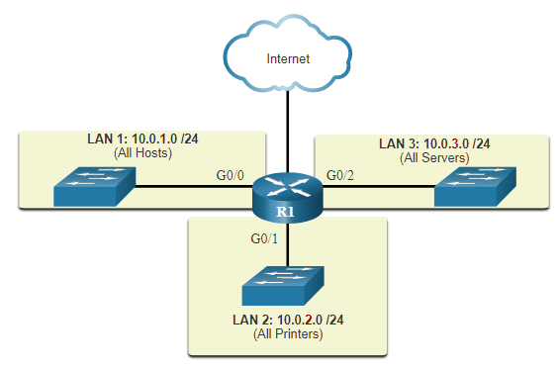
Network Segmentation Reasons for Segmenting Networks
Subnetting reduces overall network traffic and improves network performance.
It can be used to implement security policies between subnets.
Subnetting reduces the number of devices affected by abnormal broadcast traffic.
Subnets are used for a variety of reasons including by:
Location
Group or Function
Device Type
Notes:
11 – IPv4 Addressing
11.4 – Network Segmentation
11.4.3 – Reasons for Segmenting Networks
11.4.4 – Check Your Understanding - Network Segmentation

Slide 32
Check your understanding – 8.4 Network Segmentation
Notes:
2 – Basic Switch and End Device Configuration
2.2 – IOS Navigation
2.2.4 – Navigate Between IOS Modes

Slide 33
8.5 Subnet and IPv4 Network
Notes:
Cisco Networking Academy Program
Introduction to Networks v6.0
Chapter 11: IPv4 Addressing

Slide 34
Subnet an IPv4 Network Subnet on an Octet Boundary
Networks are most easily subnetted at the octet boundary of /8, /16, and /24.
Notice that using longer prefix lengths decreases the number of hosts per subnet.
Prefix Length | Subnet Mask | Subnet Mask in Binary (n = network, h = host) | # of hosts
/8 | 255.0.0.0 | nnnnnnnn.hhhhhhhh.hhhhhhhh.hhhhhhhh 11111111.00000000.00000000.00000000 | 16,777,214
/16 | 255.255.0.0 | nnnnnnnn.nnnnnnnn.hhhhhhhh.hhhhhhhh 11111111.11111111.00000000.00000000 | 65,534
/24 | 255.255.255.0 | nnnnnnnn.nnnnnnnn.nnnnnnnn.hhhhhhhh 11111111.11111111.11111111.00000000 | 254
Notes:
11 – IPv4 Addressing
11.5 – Subnet an IPv4 Network
11.5.1 – Subnet on an Octet Boundary

Slide 35
Subnet an IPv4 Network Subnet on an Octet Boundary (Cont.)
In the first table 10.0.0.0/8 is subnetted using /16 and in the second table, a /24 mask.
Subnet Address (256 Possible Subnets) | Host Range (65,534 possible hosts per subnet) | Broadcast
10.0.0.0/16 | 10.0.0.1 - 10.0.255.254 | 10.0.255.255
10.1.0.0/16 | 10.1.0.1 - 10.1.255.254 | 10.1.255.255
10.2.0.0/16 | 10.2.0.1 - 10.2.255.254 | 10.2.255.255
10.3.0.0/16 | 10.3.0.1 - 10.3.255.254 | 10.3.255.255
10.4.0.0/16 | 10.4.0.1 - 10.4.255.254 | 10.4.255.255
10.5.0.0/16 | 10.5.0.1 - 10.5.255.254 | 10.5.255.255
10.6.0.0/16 | 10.6.0.1 - 10.6.255.254 | 10.6.255.255
10.7.0.0/16 | 10.7.0.1 - 10.7.255.254 | 10.7.255.255
... | ... | ...
10.255.0.0/16 | 10.255.0.1 - 10.255.255.254 | 10.255.255.255
Subnet Address (65,536 Possible Subnets) | Host Range (254 possible hosts per subnet) | Broadcast
10.0.0.0/24 | 10.0.0.1 - 10.0.0.254 | 10.0.0.255
10.0.1.0/24 | 10.0.1.1 - 10.0.1.254 | 10.0.1.255
10.0.2.0/24 | 10.0.2.1 - 10.0.2.254 | 10.0.2.255
… | … | …
10.0.255.0/24 | 10.0.255.1 - 10.0.255.254 | 10.0.255.255
10.1.0.0/24 | 10.1.0.1 - 10.1.0.254 | 10.1.0.255
10.1.1.0/24 | 10.1.1.1 - 10.1.1.254 | 10.1.1.255
10.1.2.0/24 | 10.1.2.1 - 10.1.2.254 | 10.1.2.255
… | … | …
10.100.0.0/24 | 10.100.0.1 - 10.100.0.254 | 10.100.0.255
... | ... | ...
10.255.255.0/24 | 10.255.255.1 - 10.2255.255.254 | 10.255.255.255
Notes:
11 – IPv4 Addressing
11.5 – Subnet an IPv4 Network
11.5.1 – Subnet on an Octet Boundary (Cont.)

Slide 36
Subnet an IPv4 Network Subnet within an Octet Boundary
Refer to the table to see six ways to subnet a /24 network.
Prefix Length | Subnet Mask | Subnet Mask in Binary (n = network, h = host) | # of subnets | # of hosts
/25 | 255.255.255.128 | nnnnnnnn.nnnnnnnn.nnnnnnnn.nhhhhhhh 11111111.11111111.11111111.10000000 | 2 | 126
/26 | 255.255.255.192 | nnnnnnnn.nnnnnnnn.nnnnnnnn.nnhhhhhh 11111111.11111111.11111111.11000000 | 4 | 62
/27 | 255.255.255.224 | nnnnnnnn.nnnnnnnn.nnnnnnnn.nnnhhhhh 11111111.11111111.11111111.11100000 | 8 | 30
/28 | 255.255.255.240 | nnnnnnnn.nnnnnnnn.nnnnnnnn.nnnnhhhh 11111111.11111111.11111111.11110000 | 16 | 14
/29 | 255.255.255.248 | nnnnnnnn.nnnnnnnn.nnnnnnnn.nnnnnhhh 11111111.11111111.11111111.11111000 | 32 | 6
/30 | 255.255.255.252 | nnnnnnnn.nnnnnnnn.nnnnnnnn.nnnnnnhh 11111111.11111111.11111111.11111100 | 64 | 2
Notes:
11 – IPv4 Addressing
11.5 – Subnet an IPv4 Network
11.5.2 – Subnet within an Octet Boundary

Slide 37
Video – The Subnet Mask
Notes:
2 – Basic Switch and End Device Configuration
2.2 – IOS Navigation
2.2.4 – Navigate Between IOS Modes

Slide 38
Video – Subnet with the Magic Numbers
Notes:
2 – Basic Switch and End Device Configuration
2.2 – IOS Navigation
2.2.4 – Navigate Between IOS Modes

Slide 39
8.6 Subnet a Slash 16 and a Slash 8 Prefix
Notes:
Cisco Networking Academy Program
Introduction to Networks v6.0
Chapter 11: IPv4 Addressing

Slide 40
Subnet a Slash 16 and a Slash 8 Prefix Create Subnets with a Slash 16 prefix
The table highlights all the possible scenarios for subnetting a /16 prefix.
Prefix Length | Subnet Mask | Network Address (n = network, h = host) | # of subnets | # of hosts
/17 | 255.255.128.0 | nnnnnnnn.nnnnnnnn.nhhhhhhh.hhhhhhhh 11111111.11111111. 10000000.00000000 | 2 | 32766
/18 | 255.255.192.0 | nnnnnnnn.nnnnnnnn.nnhhhhhh.hhhhhhhh 11111111.11111111.11000000.00000000 | 4 | 16382
/19 | 255.255.224.0 | nnnnnnnn.nnnnnnnn.nnnhhhhh.hhhhhhhh 11111111.11111111.11100000.00000000 | 8 | 8190
/20 | 255.255.240.0 | nnnnnnnn.nnnnnnnn.nnnnhhhh.hhhhhhhh 11111111.11111111.11110000.00000000 | 16 | 4094
/21 | 255.255.248.0 | nnnnnnnn.nnnnnnnn.nnnnnhhh.hhhhhhhh 11111111.11111111.11111000.00000000 | 32 | 2046
/22 | 255.255.252.0 | nnnnnnnn.nnnnnnnn.nnnnnnhh.hhhhhhhh 11111111.11111111.11111100.00000000 | 64 | 1022
/23 | 255.255.254.0 | nnnnnnnn.nnnnnnnn.nnnnnnnh.hhhhhhhh 11111111.11111111.11111110.00000000 | 128 | 510
/24 | 255.255.255.0 | nnnnnnnn.nnnnnnnn.nnnnnnnn.hhhhhhhh 11111111.11111111.11111111.00000000 | 256 | 254
/25 | 255.255.255.128 | nnnnnnnn.nnnnnnnn.nnnnnnnn.nhhhhhhh 11111111.11111111.11111111.10000000 | 512 | 126
/26 | 255.255.255.192 | nnnnnnnn.nnnnnnnn.nnnnnnnn.nnhhhhhh 11111111.11111111.11111111.11000000 | 1024 | 62
/27 | 255.255.255.224 | nnnnnnnn.nnnnnnnn.nnnnnnnn.nnnhhhhh 11111111.11111111.11111111.11100000 | 2048 | 30
/28 | 255.255.255.240 | nnnnnnnn.nnnnnnnn.nnnnnnnn.nnnnhhhh 11111111.11111111.11111111.11110000 | 4096 | 14
/29 | 255.255.255.248 | nnnnnnnn.nnnnnnnn.nnnnnnnn.nnnnnhhh 11111111.11111111.11111111.11111000 | 8192 | 6
/30 | 255.255.255.252 | nnnnnnnn.nnnnnnnn.nnnnnnnn.nnnnnnhh 11111111.11111111.11111111.11111100 | 16384 | 2
Notes:
11 – IPv4 Addressing
11.6 – Subnet a Slash 16 and a Slash 8 Prefix
11.6.1 – Create Subnets with a Slash 16 prefix

Slide 41
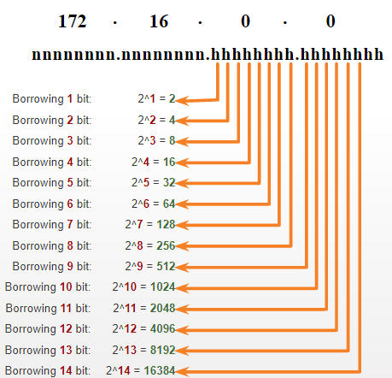
Subnet a Slash 16 and a Slash 8 Prefix Create 100 Subnets with a Slash 16 prefix
Consider a large enterprise that requires at least 100 subnets and has chosen the private address 172.16.0.0/16 as its internal network address.
The figure displays the number of subnets that can be created when borrowing bits from the third octet and the fourth octet.
Notice there are now up to 14 host bits that can be borrowed (i.e., last two bits cannot be borrowed).
To satisfy the requirement of 100 subnets for the enterprise, 7 bits (i.e., 2⁷ = 128 subnets) would need to be borrowed (for a total of 128 subnets).
Notes:
11 – IPv4 Addressing
11.6 – Subnet a Slash 16 and a Slash 8 Prefix
11.6.2 – Create 100 Subnets with a Slash 16 prefix

Slide 42
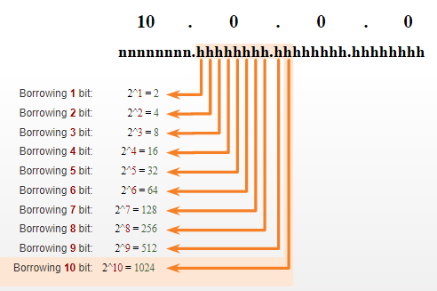
Subnet a Slash 16 and a Slash 8 Prefix Create 1000 Subnets with a Slash 8 prefix
Consider a small ISP that requires 1000 subnets for its clients using network address 10.0.0.0/8 which means there are 8 bits in the network portion and 24 host bits available to borrow toward subnetting.
The figure displays the number of subnets that can be created when borrowing bits from the second and third.
Notice there are now up to 22 host bits that can be borrowed (i.e., last two bits cannot be borrowed).
To satisfy the requirement of 1000 subnets for the enterprise, 10 bits (i.e., 2¹⁰=1024 subnets) would need to be borrowed (for a total of 128 subnets)
Notes:
11 – IPv4 Addressing
11.6 – Subnet a Slash 16 and a Slash 8 Prefix
11.6.3 – Create 1000 Subnets with a Slash 8 prefix

Slide 43
Video – Subnet Across Multiple Octets
Notes:
2 – Basic Switch and End Device Configuration
2.2 – IOS Navigation
2.2.4 – Navigate Between IOS Modes

Slide 44
Activity in Netacad: Calculate the Subnet Mask
Notes:
2 – Basic Switch and End Device Configuration
2.2 – IOS Navigation
2.2.4 – Navigate Between IOS Modes

Slide 45
8.7 Subnet to Meet Requirements
Notes:
Cisco Networking Academy Program
Introduction to Networks v6.0
Chapter 11: IPv4 Addressing

Slide 46
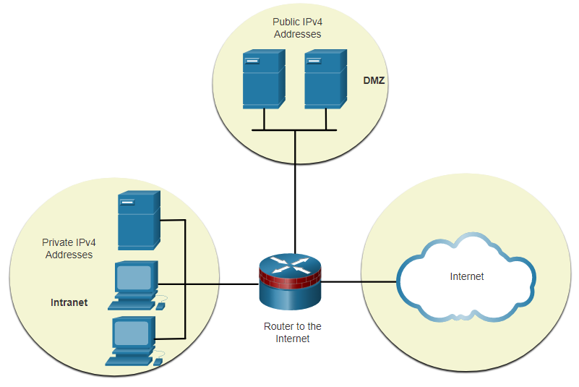
Subnet to Meet Requirements Subnet Private versus Public IPv4 Address Space
Enterprise networks will have an:
Intranet - A company’s internal network typically using private IPv4 addresses.
DMZ – A companies internet facing servers. Devices in the DMZ use public IPv4 addresses.
A company could use the 10.0.0.0/8 and subnet on the /16 or /24 network boundary.
The DMZ devices would have to be configured with public IP addresses.
Notes:
11 – IPv4 Addressing
11.7 – Subnet to Meet Requirements
11.7.1 – Subnet Private versus Public IPv4 Address Space

Slide 47
Subnet to Meet Requirements Minimize Unused Host IPv4 Addresses and Maximize Subnets
There are two considerations when planning subnets:
The number of host addresses required for each network
The number of individual subnets needed
Prefix Length | Subnet Mask | Subnet Mask in Binary (n = network, h = host) | # of subnets | # of hosts
/25 | 255.255.255.128 | nnnnnnnn.nnnnnnnn.nnnnnnnn.nhhhhhhh 11111111.11111111.11111111.10000000 | 2 | 126
/26 | 255.255.255.192 | nnnnnnnn.nnnnnnnn.nnnnnnnn.nnhhhhhh 11111111.11111111.11111111.11000000 | 4 | 62
/27 | 255.255.255.224 | nnnnnnnn.nnnnnnnn.nnnnnnnn.nnnhhhhh 11111111.11111111.11111111.11100000 | 8 | 30
/28 | 255.255.255.240 | nnnnnnnn.nnnnnnnn.nnnnnnnn.nnnnhhhh 11111111.11111111.11111111.11110000 | 16 | 14
/29 | 255.255.255.248 | nnnnnnnn.nnnnnnnn.nnnnnnnn.nnnnnhhh 11111111.11111111.11111111.11111000 | 32 | 6
/30 | 255.255.255.252 | nnnnnnnn.nnnnnnnn.nnnnnnnn.nnnnnnhh 11111111.11111111.11111111.11111100 | 64 | 2
Notes:
11 – IPv4 Addressing
11.7 – Subnet to Meet Requirements
11.7.2 – Minimize Unused Host IPv4 Addresses and Maximize Subnets

Slide 48
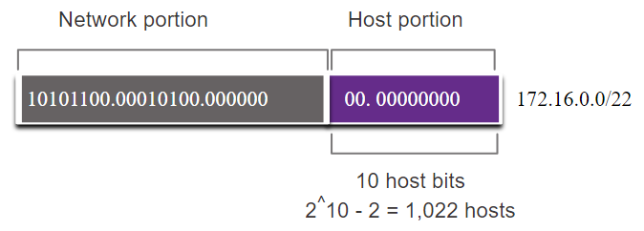
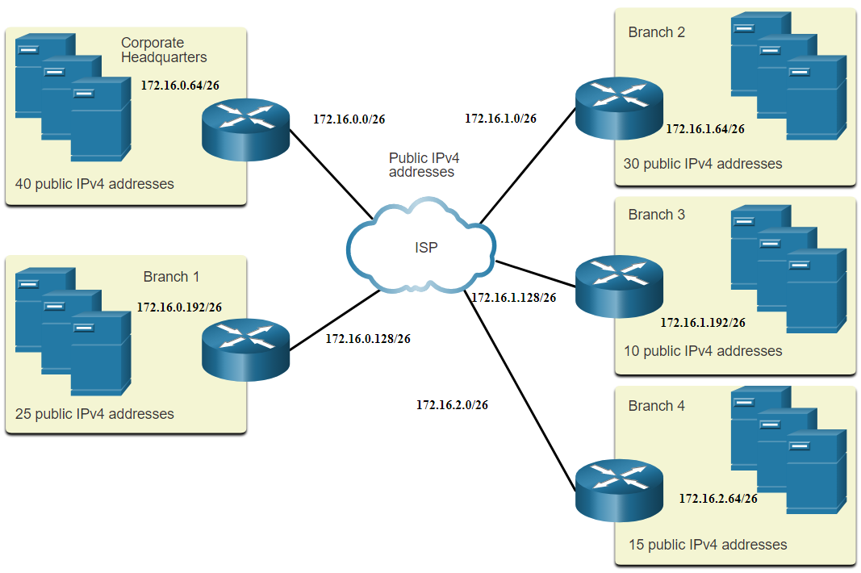
Subnet to Meet Requirements Example: Efficient IPv4 Subnetting
In this example, corporate headquarters has been allocated a public network address of 172.16.0.0/22 (10 host bits) by its ISP providing 1,022 host addresses.
There are five sites and therefore five internet connections which means the organization requires 10 subnets with the largest subnet requires 40 addresses.
It allocated 10 subnets with a /26 (i.e., 255.255.255.192) subnet mask.
Notes:
11 – IPv4 Addressing
11.7 – Subnet to Meet Requirements
11.7.3 – Example: Efficient IPv4 Subnetting
11.7.4 – Activity - Determine the Number of Bits to Borrow

Slide 49
Activity in Netacad: Determine the Number of Bits to Borrow
Notes:
2 – Basic Switch and End Device Configuration
2.2 – IOS Navigation
2.2.4 – Navigate Between IOS Modes

Slide 50
8.8 VLSM
Notes:
Cisco Networking Academy Program
Introduction to Networks v6.0
Chapter 11: IPv4 Addressing

Slide 51
Video – VLSM Basics
Notes:
2 – Basic Switch and End Device Configuration
2.2 – IOS Navigation
2.2.4 – Navigate Between IOS Modes

Slide 52
Video – VLSM Example
Notes:
2 – Basic Switch and End Device Configuration
2.2 – IOS Navigation
2.2.4 – Navigate Between IOS Modes

Slide 53
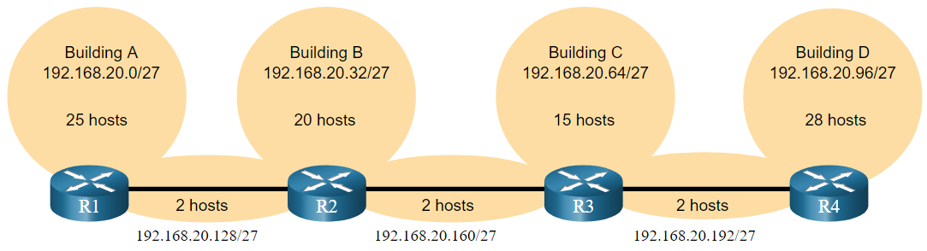
VLSM IPv4 Address Conservation
Given the topology, 7 subnets are required (i.e, four LANs and three WAN links) and the largest number of host is in Building D with 28 hosts.
A /27 mask would provide 8 subnets of 30 host IP addresses and therefore support this topology.
Notes:
11 – IPv4 Addressing
11.8 – VLSM
11.8.3 – IPv4 Address Conservation

Slide 54
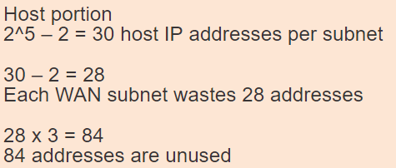
VLSM IPv4 Address Conservation (Continued)
However, the point-to-point WAN links only require two addresses and therefore waste 28 addresses each for a total of 84 unused addresses.
Applying a traditional subnetting scheme to this scenario is not very efficient and is wasteful.
VLSM was developed to avoid wasting addresses by enabling us to subnet a subnet.
Notes:
11 – IPv4 Addressing
11.8 – VLSM
11.8.3 – IPv4 Address Conservation

Slide 55
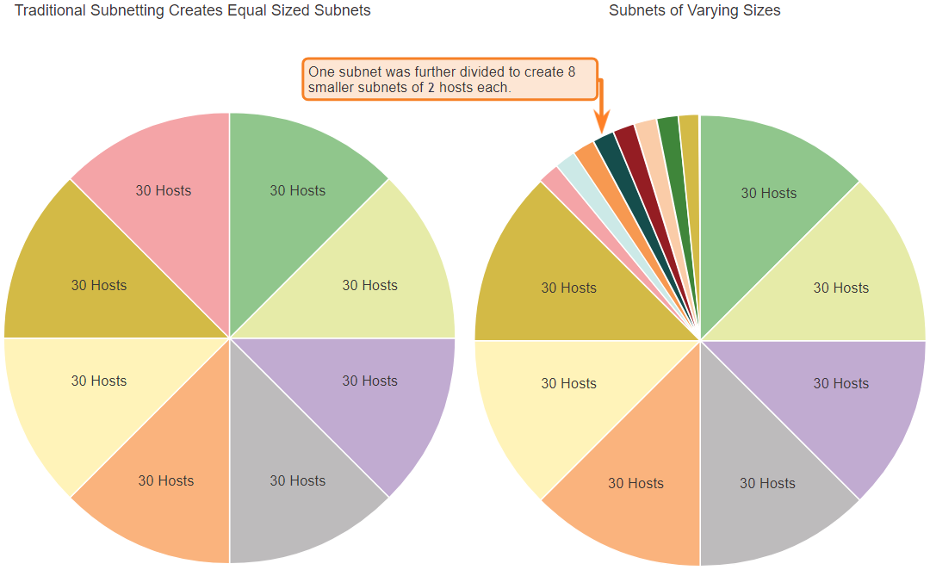
VLSM VLSM
The left side displays the traditional subnetting scheme (i.e., the same subnet mask) while the right side illustrates how VLSM can be used to subnet a subnet and divided the last subnet into eight /30 subnets.
Notes:
11 – IPv4 Addressing
11.8 – VLSM
11.8.4 – VLSM

Slide 56
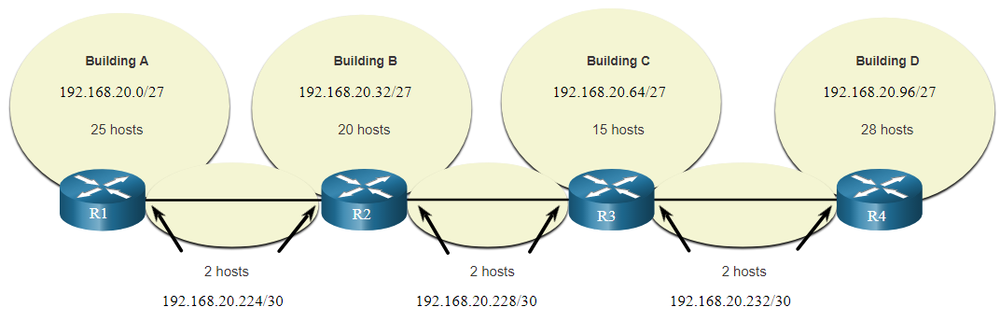
VLSM VLSM (Continued)
When using VLSM, always begin by satisfying the host requirements of the largest subnet and continue subnetting until the host requirements of the smallest subnet are satisfied.
The resulting topology with VLSM applied.
Notes:
11 – IPv4 Addressing
11.8 – VLSM
11.8.4 – VLSM

Slide 57
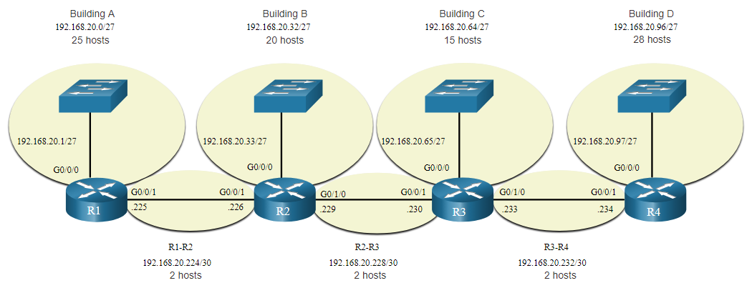
VLSM VLSM Topology Address Assignment
Using VLSM subnets, the LAN and inter-router networks can be addressed without unnecessary waste as shown in the logical topology diagram.
Notes:
11 – IPv4 Addressing
11.8 – VLSM
11.8.5 – VLSM Topology Address Assignment
11.8.6 – Activity - VLSM Practice

Slide 58
Activity in Netacad: VLSM Practice
Notes:
2 – Basic Switch and End Device Configuration
2.2 – IOS Navigation
2.2.4 – Navigate Between IOS Modes

Slide 59
8.9 Structured Design
Notes:
Cisco Networking Academy Program
Introduction to Networks v6.0
Chapter 11: IPv4 Addressing

Slide 60
Structured Design IPv4 Network Address Planning
IP network planning is crucial to develop a scalable solution to an enterprise network.
To develop an IPv4 network wide addressing scheme, you need to know how many subnets are needed, how many hosts a particular subnet requires, what devices are part of the subnet, which parts of your network use private addresses, and which use public, and many other determining factors.
Examine the needs of an organization’s network usage and how the subnets will be structured.
Perform a network requirement study by looking at the entire network to determining how each area will be segmented.
Determine how many subnets are needed and how many hosts per subnet.
Determine DHCP address pools and Layer 2 VLAN pools.
Notes:
11 – IPv4 Addressing
11.9 – Structured Design
11.9.1 – IPv4 Network Address Planning

Slide 61
Structured Design Device Address Assignment
Within a network, there are different types of devices that require addresses:
End user clients – Most use DHCP to reduce errors and burden on network support staff. IPv6 clients can obtain address information using DHCPv6 or SLAAC.
Servers and peripherals – These should have a predictable static IP address.
Servers that are accessible from the internet – Servers must have a public IPv4 address, most often accessed using NAT.
Intermediary devices – Devices are assigned addresses for network management, monitoring, and security.
Gateway – Routers and firewall devices are gateway for the hosts in that network.
When developing an IP addressing scheme, it is generally recommended that you have a set pattern of how addresses are allocated to each type of device.
Notes:
11 – IPv4 Addressing
11.9 – Structured Design
11.9.2 – Device Address Assignment

Slide 62
Quick Review Question
Refer to Quiz - Chapter 11 in Cisco Networking Academy platform

Slide 63
Summary of Main Teaching Points
Explain the use of IPv4 addresses to provide connectivity in a small to medium-sized business network.
The IP addressing structure consists of a 32-bit hierarchical network address that identifies a network and a host portion.
Network devices use a process called ANDing using the IP address and associated subnet mask to identify the network and host portions.
Reduce large broadcast domains using subnets to create smaller broadcast domains, reduce overall network traffic, and improve network performance.
Create IPv4 subnets using one or more of the host bits as network bits. However, networks are most easily subnetted at the octet boundary of /8, /16, and /24.

Slide 64
Summary of Main Teaching Points
Larger networks can be subnetted at the /8 or /16 boundaries.
Use VLSM to reduce the number of unused host addresses per subnet.
VLSM allows a network space to be divided into unequal parts. Always begin by satisfying the host requirements of the largest subnet. Continue subnetting until the host requirements of the smallest subnet are satisfied.
When designing a network addressing scheme, consider internal, DMZ, and external requirements. Use a consistent internal IP addressing scheme with a set pattern of how addresses are allocated to each type of device.

Slide 65
Question and Answer Session
Q & A

Slide 66
What we will cover next
IPv6 Addressing

Slide 67
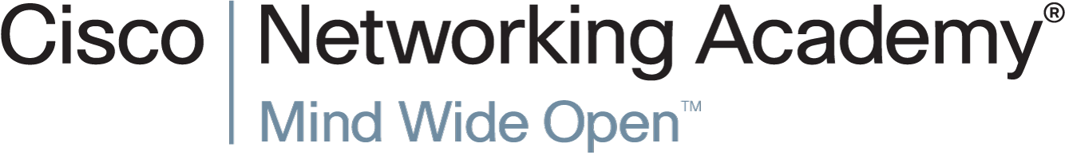

Slide 68


